Slide 1
Employee Management System
Using C++

Slide 2
Objectives:
To view list of employees.
To add an employee.
To modify details.
To view employee details.
To remove the details.
Conclusion.

Slide 3
Introduction:
The objective of this project is to create an employee management system using the concepts of oops (object oriented programming) in C++.
The concepts used:
Class
Abstraction
Encapsulation

Slide 4
Header Files used:
Iostream: To access the input output built in functions of the language.
Conio.h: Used for console input/output functions.
Cstdlib: Defines several general purpose functions.
Cstring: Defines several functions to manipulate C strings and arrays.
Cstdio: Operates with physical devices or with any other type of files supported by the system.

Slide 5
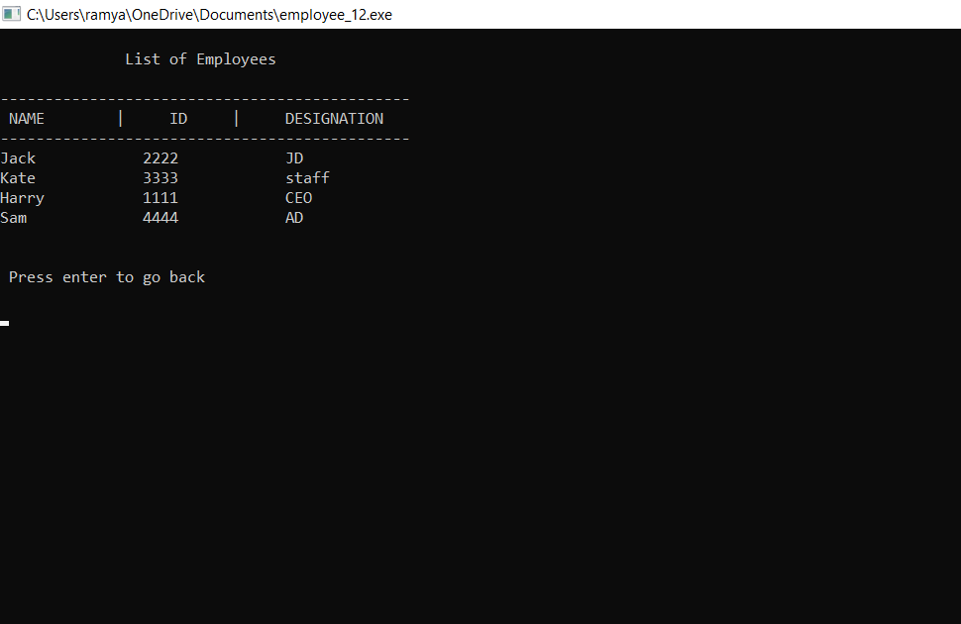
listEmployee()
file= fopen("data.txt", "r");
Iterates until the end of file.
This function is used to display the list of employees in a file.
fclose(file);
waitForEnter():which takes input from the user for next command

Slide 6
addNewEmployee()
Start module
Set variable var equal to y
While var equal to y then
read name,id and designation
write the data to the file
display add var record,read yes or no
If yes then
read name,id and designation
Else
return
End while
End module

Slide 7
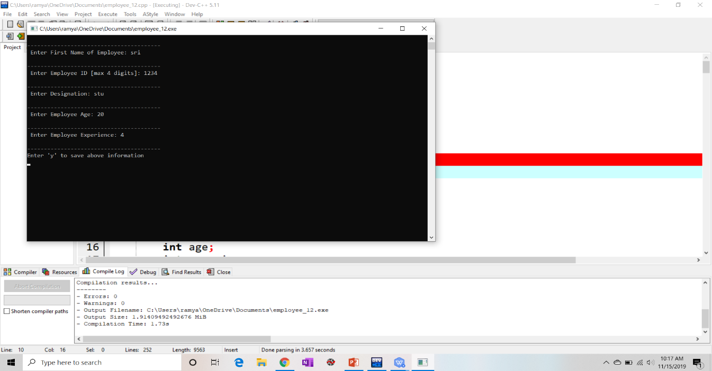
Outputs:

Slide 8
editExisting()
This function is used to modify the employee’s information.
In this module , the user enters the id of the employee , whose information is to be modified.
Then the user enters new details of the employee.
The new details of the employee are entered into the file.

Slide 9
editExisting()
Steps used to modify employee details are:
Enter the employee id , new designation and new ctc .
Create two file pointers *file,*tempfile .
Set fopen(“file.txt”,”r”) to ‘file’ pointer.
Set fopen(“new_file.txt”,”w”) to ‘tempfile’.
Compare ‘checkId’ with all other Id’s.
If checkId == id, write new details to ‘tempfile’.
Else, write the old details to ‘tempfile’.

Slide 10
Cont…
6. Then close the old file and modified file .
7. Now remove the data in the old file.
8. Move the contents of modified file(new_file) to the old file(file).

Slide 11
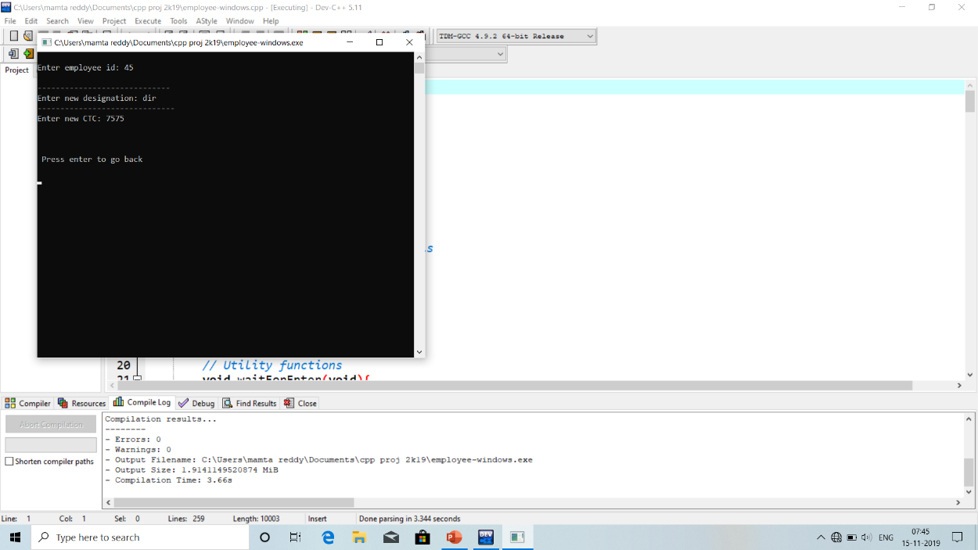
Output:
The id of the employee is entered by the user.
Then the new designation , new ctc are entered and stored into the file.

Slide 12
show details()
when function is called curser moved to the definition part
A pointer file is created of datatype file and character of data type char
Opening a file of mode reading
Now,it checks when our checkId is matched with the id of data in the file it prints the respective data
Close the file
Now curser moves to the next line of function call

Slide 13
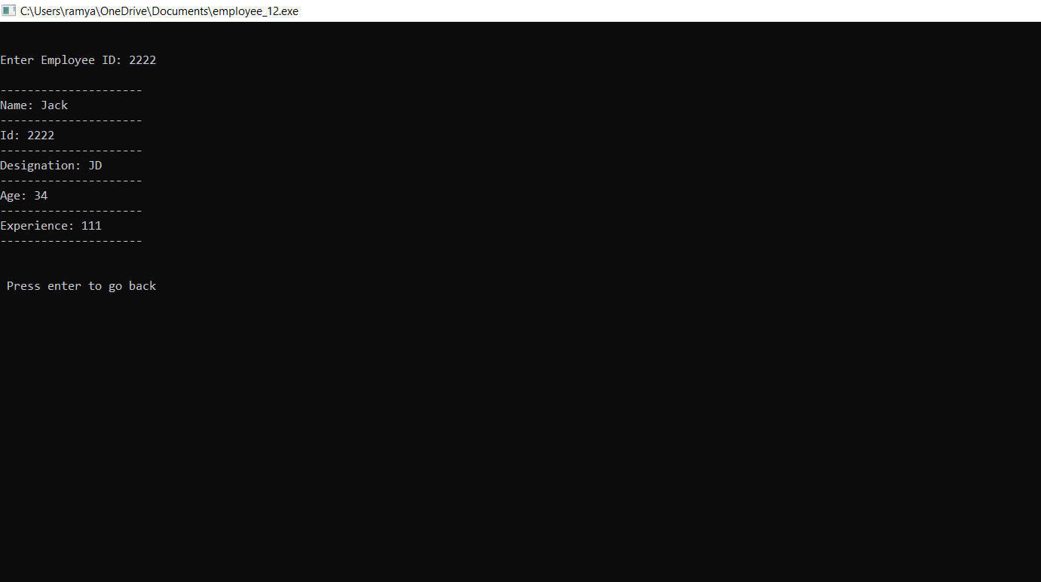
OUTPUT
Employee id is entered
Respective details of the employee is shown in output

Slide 14
DeleteEmployeeDetails()
Enter employee id(checkId) to delete
Open the existing file and create a temp file.
Iterates until the EOF.
Copies all entries into the temp file, excluding the entry to be removed.
Fclose(file)
Fclose(tempfile)
waitForEntry()

Slide 15
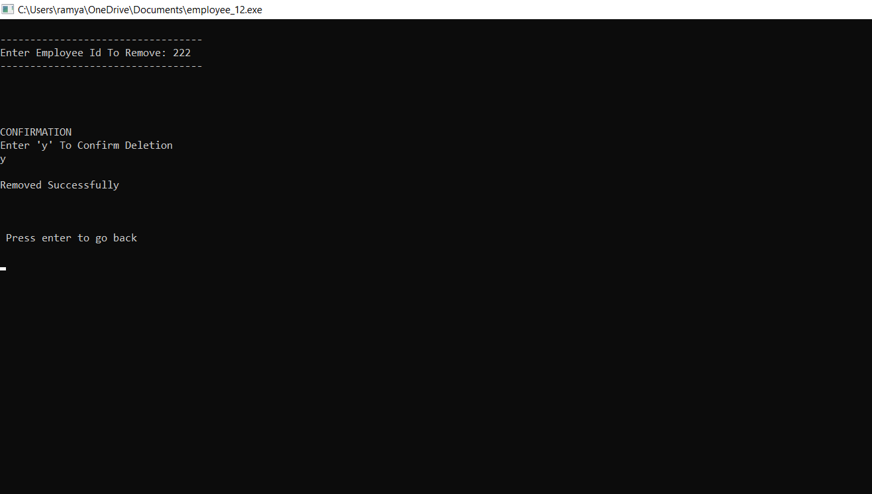
Output
Employee id is entered
Conformation is asked and the record is deleted.

Slide 16
Conclusion
Detailed understanding of features of OOPs
Practical implementation of OOPs and files.

